Slide 1
Modeling Sequential Data Using RNNs
Oualid Missaoui

Slide 2
Historical development
RNN
LSTM
GRU
Attention
Transformer

Slide 3
Recurrent Neural Networks (RNN)
History:
Hopfield networks, John Hopfield 1982 (still alive)
David Rumelhart’s in 1986 (died 2011)
=

Slide 4
RNN structure
H,W, U are learnable parameters and the same for all time steps

Slide 5
Different RNN architectures
One to one (Standard feed-forward neural network)
One to Many
Many to One
Many to Many (same sequence lengths)
Many to Many (different sequence lengths)

Slide 6
One to many RNN architecture
Image captioning
Music generation
Finance applications ?

Slide 7
One to many RNN architecture
Typical applications:
The output is a characterization of the overall sequence
The output does not change much over time
Applications
Sentiment classification
Sequence classification
Financial application:
Predicting the follow-on transactions with many-to-one
Predicting tuck-ins, m&a/LBO, etc

Slide 8
Many-to-many RNNs (same size)
When to use:
When the output is available whenever the input is available and represents a significant/interesting characterization
Applications
Name Entity Recognition
Financial Applications
Asset return prediction (classification/regression)
Stocks, bonds
Security level trading volume/imbalance prediction

Slide 9
Many-to-many RNNs (different size)
Typical application
When the output is a sequence that should not coincide with the input sequence
Applications
Machine translation
Financial application
Temporal structured prediction: predicting the timelines of major events in the first 5 years of the public life of a firm (output sequence) from its private life (input sequence)

Slide 10
Bidirectional RNN

Slide 11
RNN issues
Like Deep feed-forward neural networks, RNN suffer from vanishing/exploding gradient
Solution: LSTM comes to the rescue

Slide 12
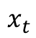
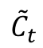
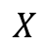
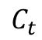
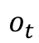
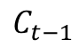
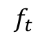
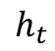
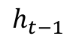
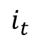
Long Short-Term Memory (LSTM) Neural Networks
Updating scheme:
$$C_{t−1}$$
$$C_{t}$$
$$f_{t}$$
$$i_{t}$$
$${\tilde{C}}_{t}$$
=
$$o_{t}$$
$$h_{t−1}$$
$$h_{t}$$
$$X$$
$$x_{t}$$
Forget gate:
decides what information should be thrown away or kept
Input gate :
regulated input
Cell gate :
combines forget and input states
Output gate:
The output gate decides what the next hidden state should be.

Slide 13
GRU-RNN

Slide 14
LSTM vs GRU

Slide 15
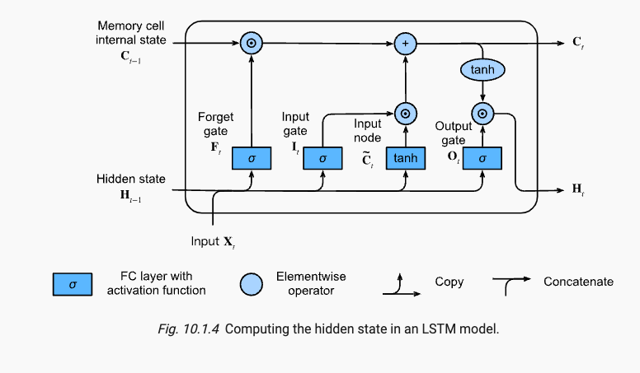
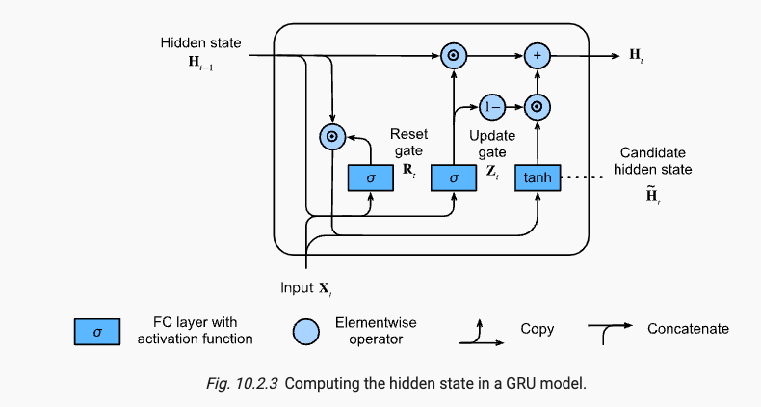
LSTM vs GRU

Slide 16
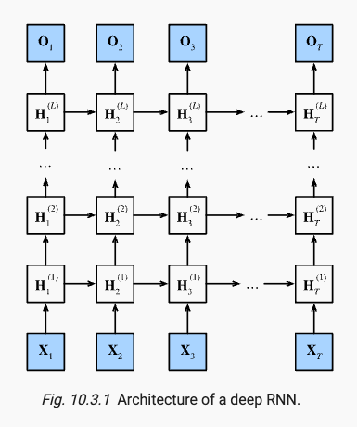
Deep RNN

Slide 17
Deep LSTM

Slide 18
Encoder-Decoder LSTM (Seq2Seq)

Slide 19
Encoder
Decoder : compute hidden state from
Previous hidden state
Last hidden vector of encoder
Previous predicted output

Slide 20
Seq2Seq prediction
Greedy Search
Exhaustive Search
Beam search

Slide 21
Limitations of Seq2Seq architectures
A limitation of the architecture is that it encodes the input sequence to a fixed length internal representation.
This imposes limits on the length of input sequences that can be reasonably learned and results in worse performance for very long input sequences.

Slide 22
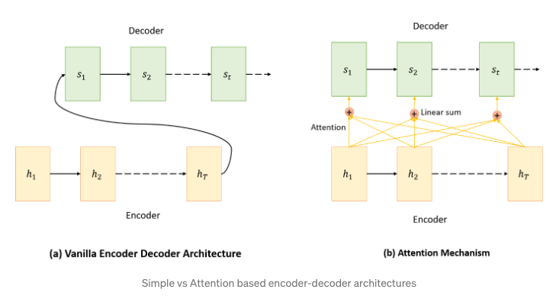
LSTM with attention
In a simple Encoder-Decoder architecture the decoder is supposed to start making predictions by looking only at the final output of the encoder step which has condensed information.
On the other hand, attention based architecture attends every hidden state from each encoder node at every time step and then makes predictions after deciding which one is more informative.

Slide 23
The alignment model a is parametrized as a feedforward neural network which is jointly trained with all the other components of the proposed system
Dzmitry Bahdanau, KyungHyun Cho, Yoshua Bengio, NEURAL MACHINE TRANSLATION BY JOINTLY LEARNING TO ALIGN AND TRANSLATE, ICLR 2015

Slide 25
Minh-Thang Luong, Hieu Pham, Christopher D. Manning, Effective Approaches to Attention-based Neural Machine Translation, EMNLP 2015

Slide 26
Transformer’s architecture

Slide 27
Ashish Vaswani, Noam Shazeer, Niki Parmar, Jakob Uszkoreit, Llion Jones, Aidan N. Gomez, Lukasz Kaiser, Illia Polosukhin, Attention Is All You Need, NIPS 2017

Slide 28
Let’s get real, how can we train (deep) LSTM ?
Obviously, we need data , that has a time component
We have tons of panels that we can experiment with, e.g. bond’s market flow imbalance prediction , i.e. predicting if a bond will have more dealer buy quantity than dealer sell quantity
Suppose we have N bonds, and for each bond we have one year of weekly data so that every week t, we can characterize each bond by K features, and we map the features to an output for that particular bond that checks if the following week has more dealer buys than sells or not
Therefore , we will have a panel
The input to the LSTM will a set of N ”data points” where each data point i is:

Slide 29
How tf/keras handles it
# define model
model = Sequential()
model.add(LSTM(50, activation='relu', input_shape=(n_steps, n_features)))
model.add(Dense(1))
model.compile(optimizer='adam', loss='mse')
For many-to-many (same size) , Tf/Keras expects a multi-dimensional array :
Training shape = [tr_n_samples, n_timesteps, n_features]
And since it is same-size, the testing data ndarray should have the shape
Testing shape = [tst_n_samples, n_timesteps, n_features]
Back to our panel:
Training, n_timesteps < T
t0
t1
T
Testing, n_timesteps < T
For the current problem, we are interested in the FIRST prediction
Y0 in the testing sequence

Slide 30
Tf/keras configuration
One-to-one
model.add(Dense(output_size, input_shape=input_shape))
One-to-many
model.add(RepeatVector(number_of_times, input_shape=input_shape))
model.add(LSTM(output_size, return_sequences=True))
Many-to-one
model = Sequential()
model.add(LSTM(1, input_shape=(timesteps, data_dim)))
Many-to-many
model = Sequential()
model.add(LSTM(1, input_shape=(timesteps, data_dim), return_sequences=True))

